Slide 1


Brain Health Challenge Progress report II
Antonia
Weiping

Slide 2
Statistics and Hypothesis tests

Slide 3
Do patients with sleep disturbances get diagnosed with AD earlier?

Slide 4
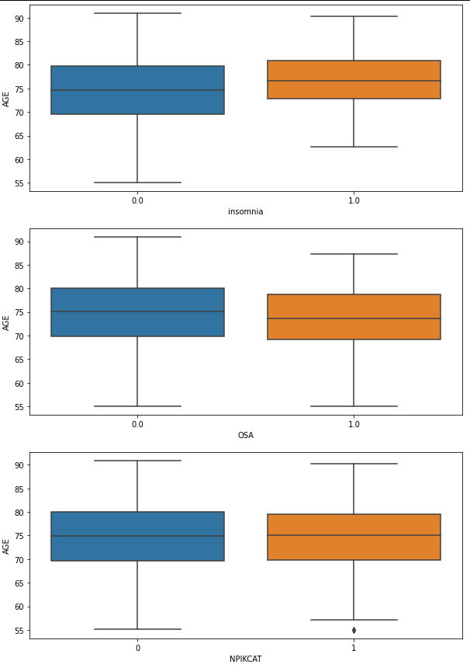
Do patients with sleep disturbances get diagnosed with AD earlier?
Age when diagnosed with Alzheimers
insomnia | count | mean | std | min | median | max
no | 677 | 74.272378 | 7.683623 | 55.0 | 74.7 | 90.9
yes | 49 | 76.336735 | 6.377653 | 62.7 | 76.7 | 90.3
OSA | count | mean | std | min | median | max
no | 661 | 74.588502 | 7.601155 | 55.1 | 75.1 | 90.9
yes | 65 | 72.613846 | 7.596131 | 55.0 | 73.6 | 87.3
NPIKCAT | count | mean | std | min | median | max
Low (<=3) | 612 | 74.440523 | 7.688397 | 55.1 | 74.9 | 90.9
High (>3) | 114 | 74.257018 | 7.248130 | 55.0 | 75.1 | 90.3

Slide 5
Do patients with sleep disturbances get diagnosed with AD more often?

Slide 6
Sleep Marker | NL | MCI | AD
OSA no | 0.400851 | 0.405355 | 0.193794
OSA yes | 0.271871 | 0.551817 | 0.176312
Insomnia no | 0.391742 | 0.410093 | 0.198165
Insomnia yes | 0.347781 | 0.524252 | 0.127967
NPIKCAT low | 0.400375 | 0.407416 | 0.192209
NPIKCAT high | 0.340143 | 0.468594 | 0.191263

Slide 7
Do sleep disturbances increase the risk of AD?

Slide 8
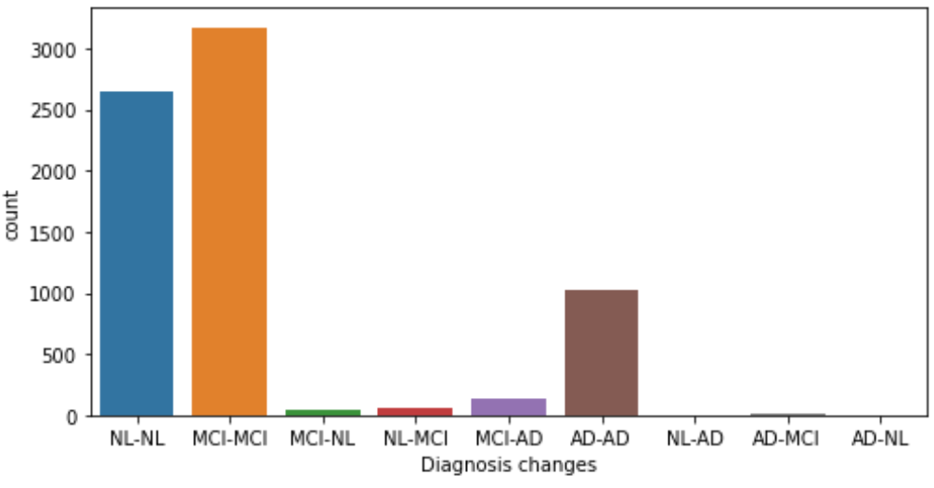
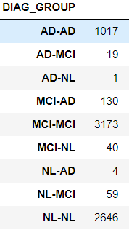
Sleep vs diagnosis changes
# 7089 observations
# 13 independent variables: 11 NPIK-features, OSA, insomnia
# binary classification with 10-fold cross-validation
# use balanced target labels for modeling (by undersampling)

Slide 9
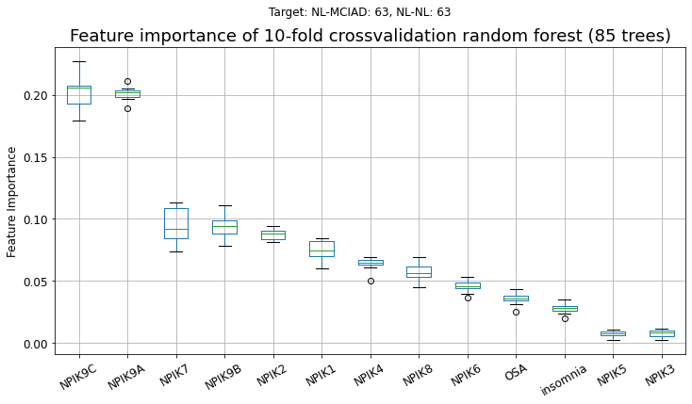
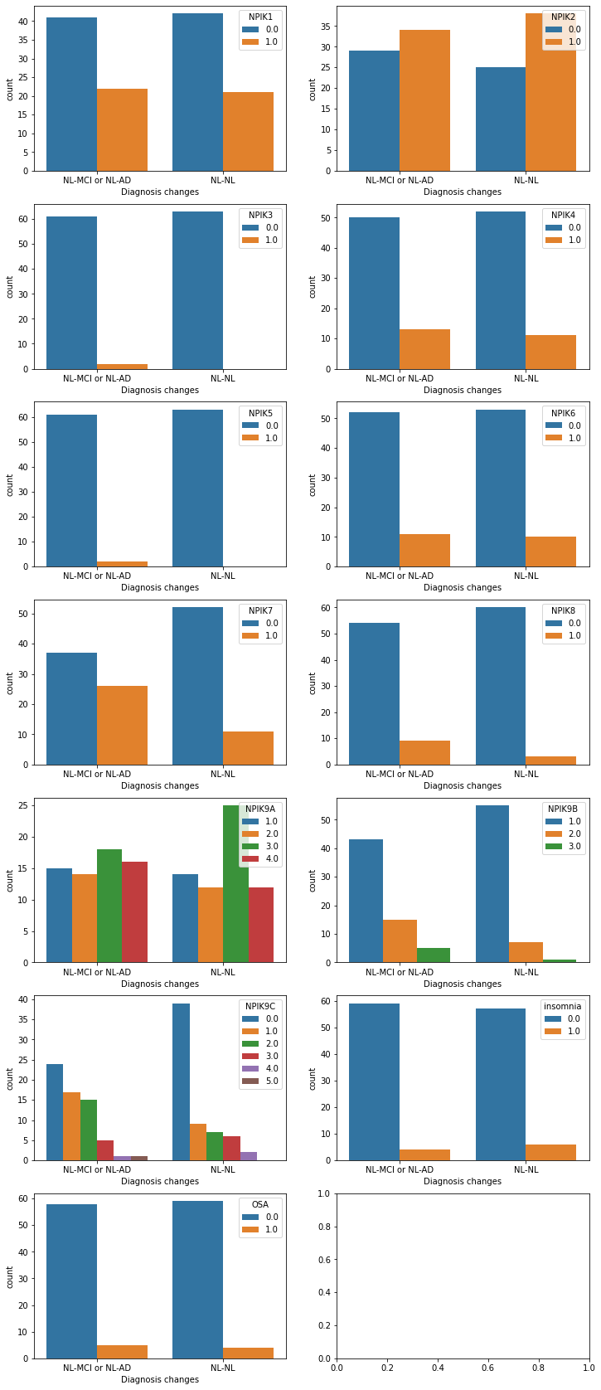
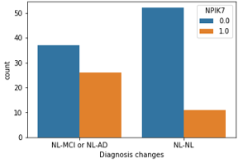
Part1: Will my status get worse or not? (as NL)
NL --> MCI/AD or NL --> NL
63 samples in each class
Top 3 important features:
NPIK9C:
Caregiver Distress
0=Not at all; 1=Minimally; 2=Mildly; 3=Moderately;
4=Severely; 5=Very severely or extremely
NPIK9A:
Frequency Ratings
1= Occasionally; 2= Often; 3= Frequently; 4= Very frequently
NPIK7:
Does patient sleep excessively during the day?
0=No; 1=Yes
Sleep vs diagnosis changes
F1-score: 0.61

Slide 10
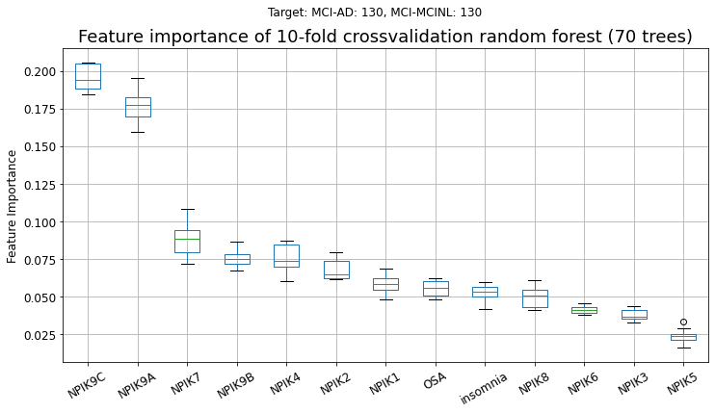
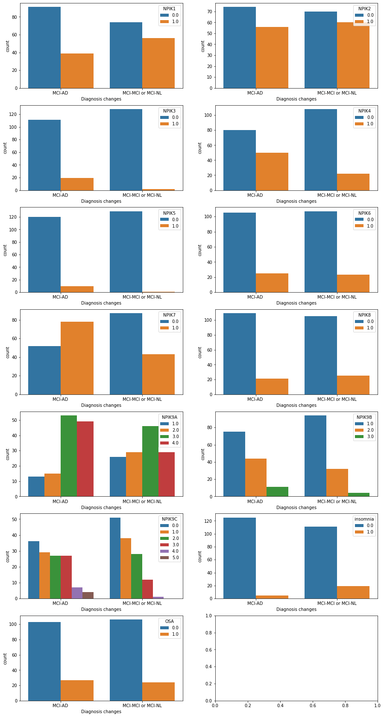
Part1: Will my status get worse or not? (as MCI)
MCI --> AD or MCI --> MCI/NL
130 samples in each class
Top 3 important features:
NPIK9C:
Caregiver Distress
0=Not at all; 1=Minimally; 2=Mildly; 3=Moderately;
4=Severely; 5=Very severely or extremely
NPIK9A:
Frequency Ratings
1= Occasionally; 2= Often; 3= Frequently; 4= Very frequently
NPIK7:
Does patient sleep excessively during the day?
0=No; 1=Yes
Sleep vs diagnosis changes
F1-score: 0.70

Slide 11
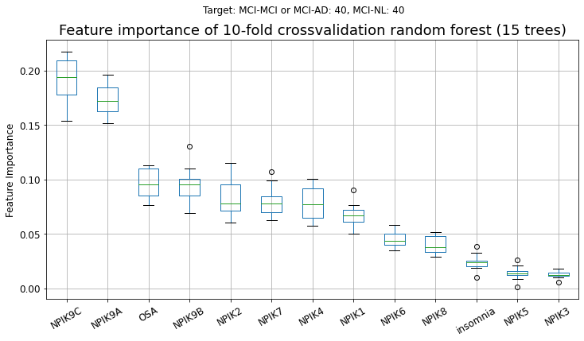
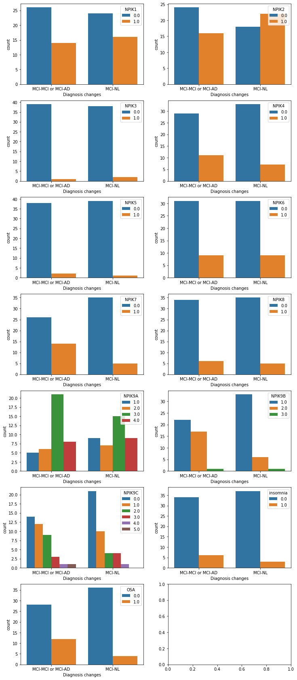
Sleep vs diagnosis changes
Part1: Will my status get better or not? (as MCI)
MCI --> NL or MCI --> MCI/AD
40 samples in each class
Top 3 important features:
NPIK9C:
Caregiver Distress
0=Not at all; 1=Minimally; 2=Mildly; 3=Moderately;
4=Severely; 5=Very severely or extremely
NPIK9A:
Frequency Ratings
1= Occasionally; 2= Often; 3= Frequently; 4= Very frequently
OSA:
Obstructive sleep apnea
0=No; 1=Yes
F1-score: 0.60

Slide 12
Sleep vs diagnosis changes
Goal | Target labels | F1-score | 1st important feature | 2nd important feature | 3rd important feature
Will the health status get worse? (based on sleep quality data) | NL --> MCI/AD (worse) Nl --> NL (not worse) | 0.61 | NPIK9C | NPIK9A | NPIK7
 | MCI --> AD (worse) MCI --> MCI/NL (not worse) | 0.70 | NPIK9C | NPIK9A | NPIK7
Will the health status get better? (based on sleep quality data) | MCI --> NL (better) MCI --> MCI/AD (not better) | 0.60 | NPIK9C | NPIK9A | OSA
NPIK9C: ​ Caregiver Distress​
NPIK9A: ​ Frequency of Sleep disturbances Ratings​
NPIK7: ​ Does patient sleep excessively during the day?​
OSA: Obstructive sleep apnea

Slide 13

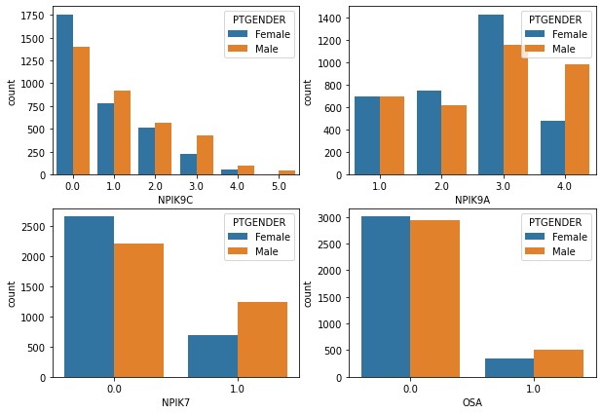
Top sleep features vs gender
- more males get severe caregiver distress than females (NPIK9C)
- (NPIK9A) number of males get very frequently disturbances (class 4) is twice as females
- (NPIK7) more males sleep excessively during the day
- more males have OSA
-- likely more males in the dataset have sleep problems than female

Slide 14
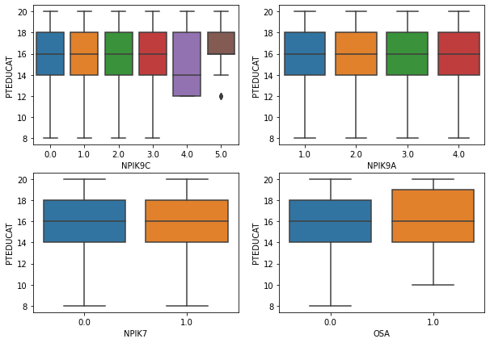
Top sleep features vs education

Slide 15
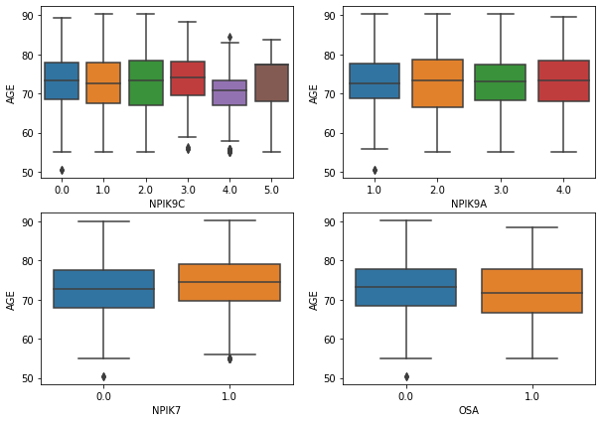
Top sleep features vs age

Slide 16
Do brain volumes correlate with AD?

Slide 17
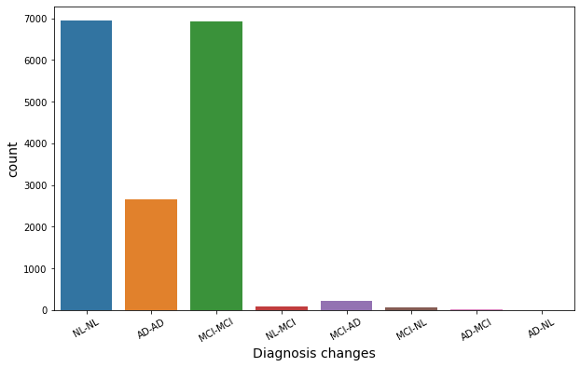
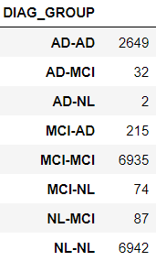
Relative brain volume vs diagnosis changes
# 16939 observations
# 6 independent variables: relative volume (to baseline) of Ventricles, Hippocampus, Wholebrain, Entorhinal, Fusiform, ICV
# binary classification with 10-fold cross-validation
# use balanced target labels for modeling (by undersampling)

Slide 18
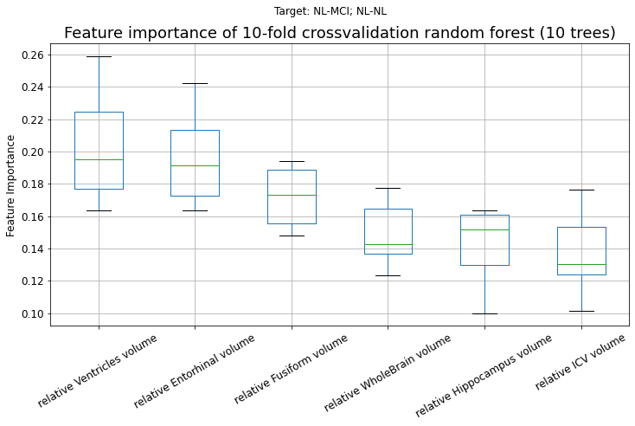
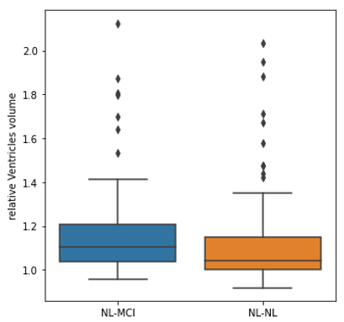
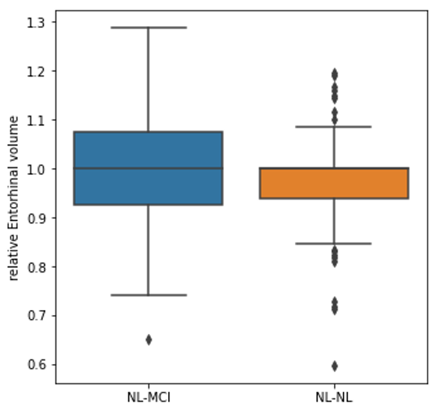
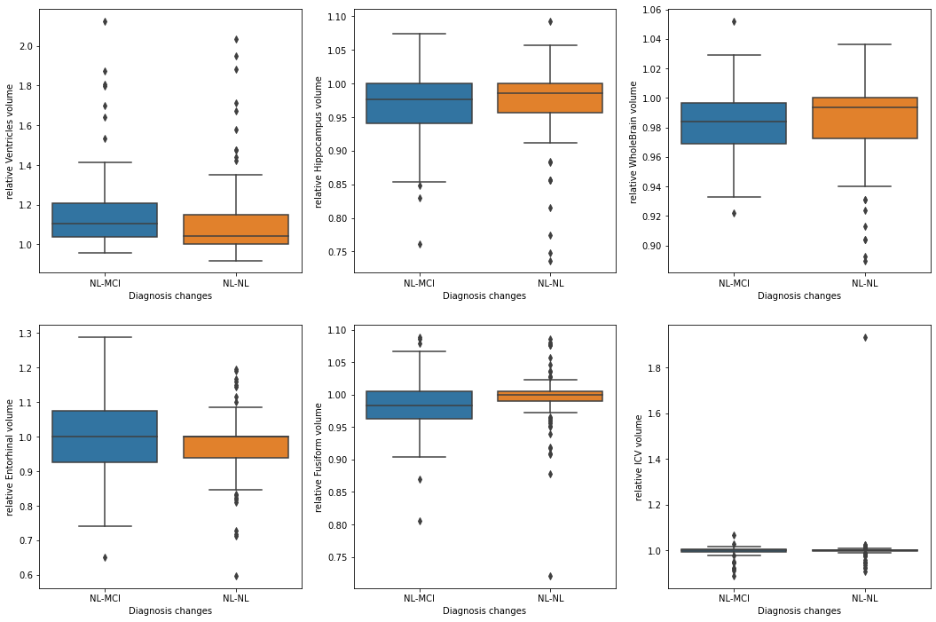
Relative brain volume vs diagnosis changes
Part1: Will my status get worse or not? (as NL)
NL --> MCI or NL --> NL
87 samples in each class
The relative brain volume is calculated
by dividing the the brain volume of the first visit
Top 3 important features:
Relative Ventricles volume
Relative Entorhinal volume
Relative Fusiform volume
F1-score: 0.61
Ventricles Entorhinal Fusiform Wholebrain Hippocampus ICV
Relative Ventricles volume Relative Entorhinal volume Relative Fusiform volume

Slide 19
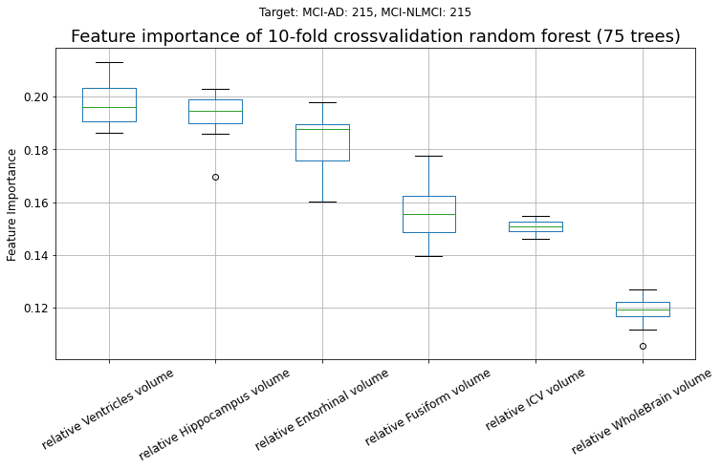
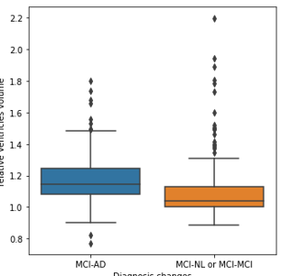
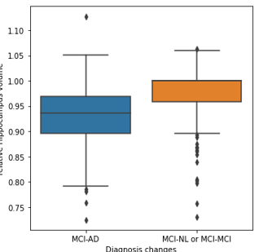
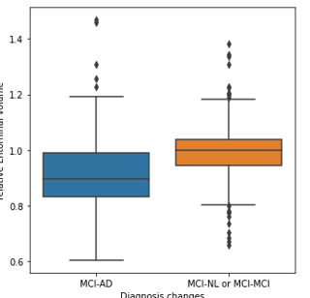
Relative brain volume vs diagnosis changes
Part1: Will my status get worse or not? (as MCI)
MCI --> NL/MCI or MCI --> AD
215 samples in each class
The relative brain volume is calculated
by dividing the brain volume of the first visit
Top 3 important features:
Relative Ventricles volume
Relative Hippocampus volume
Relative Entorhinal volume
F1-score: 0.80
Ventricles Hippocampus Entorhinal Fusiform ICV Wholebrain
Relative Ventricles volume Relative Hippocampus volume Relative Entorhinal volume

Slide 20
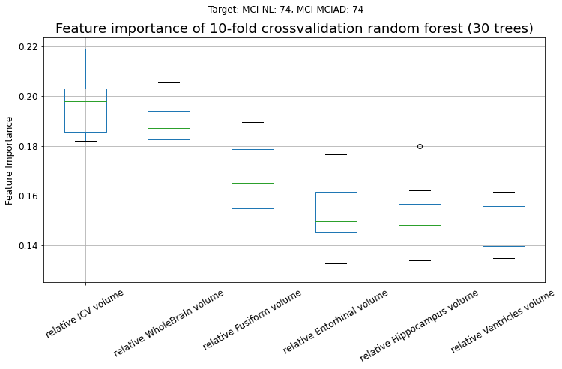
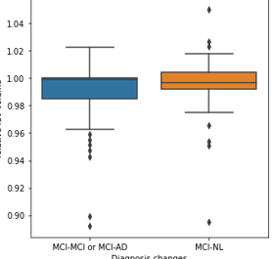
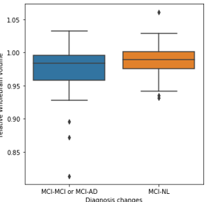
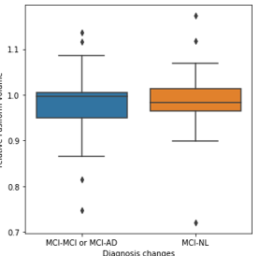
Relative brain volume vs diagnosis changes
Part2: Will my status get better or not? (as MCI)
MCI --> AD or MCI --> NL/MCI
74 samples in each class
The relative brain volume is calculated
by dividing the the brain volume of the first visit
Top 3 important features:
Relative ICV volume
Relative Wholebrain volume
Relative Fusiform volume
F1-score: 0.62
ICV Wholebrain Fusiform Entorhinal Hippocampus Ventricles
Relative ICV volume Relative Wholebrain volume Relative Fusiform volume

Slide 21
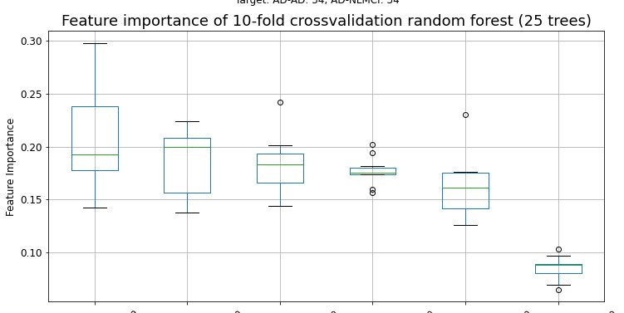
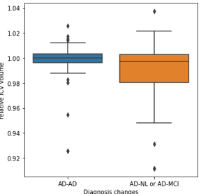
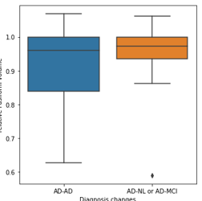
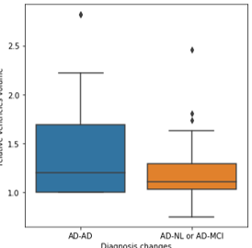
Relative brain volume vs diagnosis changes
Part2: Will my status get better or not? (as AD)
AD --> AD or AD --> NL/MCI
34 samples in each class
The relative brain volume is calculated
by dividing the the brain volume of the first visit
Top 3 important features:
Relative ICV volume
Relative Fusiform volume
Relative Ventricles volume
F1-score: 0.68
ICV Fusiform Ventricles Wholebrain Hippocampus Entorhinal
Relative ICV volume Relative Fusiform volume Relative Ventricles volume

Slide 22
Relative brain volume vs diagnosis changes
Goal | Target labels | F1-score | 1st important feature | 2nd important feature | 3rd important feature
Will the health status get worse? | NL --> MCI (worse) Nl --> NL (not worse) | 0.61 | Ventricles | Entorhinal | Fusiform
 | MCI --> AD (worse) MCI --> MCI/NL (not worse) | 0.80 | Ventricles | Hippocampus | Entorhinal
Will the health status get better? | MCI --> NL (better) MCI --> MCI/AD (not better) | 0.62 | ICV | Wholebrain | Fusiform
 | AD --> MCI/NL ( better) AD --> AD (not better) | 0.68 | ICV | Fusiform | Ventricles
* All features are relative brain volume

Slide 23
Predicting change from MCI or NL to AD
Logistic regression using insomnia, OSA and NPIKTOT as well as brain volume to predict AD patients in the MCL-AD and NL-AD patient group
Method | CV (10 folds)
No sleep markers, using ratio of brain volume | 0.668876
Using insomnia & ratio of brain volume | 0.673259
Using OSA & ratio of brain volume | 0.670778
Using NPIKTOT & ratio of brain volume | 0.680767
Using all of them & ratio of brain volume | 0.684579

Slide 24
Conclusion
Patients with insomnia or a high NPIK score seem to not be diagnosed with AD earlier in life or more often. For OSA there might be some evidence that they get AD earlier
Sleep markers were able to predict diagnosis changes with an accuracy of 60-70%
Relative brain volumes were able to predict diagnosis changes with an accuracy of 61-80%
Using both sleep markers and brain volume ratios yielded a result of 66 – 68%, however the use of sleep markers did not improve the model much

Slide 25
Questions
What to look out for in the images

